Slide 1
Interreg-IPA Cross-border Cooperation Programme Romania-Serbia
Communication and Visual Identity requirements
www.romania-serbia.net
June 2019

Slide 2
Communication should support the projects by bringing their results and benefits to the attention of relevant groups or the general public, using plain language.
Common rules apply for all project partners:
The Visual Identity Manual and models of various communication tools can be found on: www.romania-serbia.net in the Implementation – Visibility section.

Slide 3
Communication Strategy
Objectives of the strategy:
support the successful implementation of the project;
increase public awareness concerning the project and its results;
ensure transparency in the use of funds;
highlight the role of the European Union.

Slide 4
Responsibilities:
Lead beneficiary
responsible for informing the public about the funding obtained from the European Union.
Project partners
responsible to implement all the communication activities described in the project.

Slide 5
Requirements:
Communicator - responsible with communication;
(project outputs) clear reference to EU contribution;
mandatory A3 posters;
location signs for the implementation of the projects;
mandatory billboards (if the case);
permanent plaques or billboards (if the case).
Good quality PHOTOS!

Slide 6
European Union flag
The flag is a symbol of European identity and unity.
Typeface:
Arial: EUROPEAN UNION
Calibri: EUROPEAN UNION
Trebuchet MS: EUROPEAN UNION
Tahoma: EUROPEAN UNION
Verdana: EUROPEAN UNION
Ubuntu: EUROPEAN UNION
The EU flag shall always be visible;
The EU flag shall be displayed in colour;
The monochrome version used only in justified cases;
EUROPEAN UNION shall be spelled out in full.
Language
versions:

Slide 7
The official full name of the Programme is:
Interreg-IPA Cross-border Cooperation
Romania-Serbia Programme
Language variations:
Programul Interreg-IPA de Cooperare Transfrontalieră România-Serbia
Interreg-IPA Program prekogranične saradnje Rumuniјa-Srbiјa
Интерег-ИПА Програм прекограничне сарадње Румунија-Србија

Slide 8
Short version names:
Interreg-IPA CBC Romania-Serbia Programme
Programul Interreg-IPA CBC România-Serbia
Interreg-IPA CBC Program Rumuniјa – Srbiјa
Интерег-ИПА ЦБЦ Програм Румунија – Србија
Public Communication
Do not use other names for the Interreg-IPA Cross-border Cooperation Romania-Serbia Programme.
Use the technical language and short terms carefully:
”IPA”, ”IPA-CBC”, ”eligibility”, ”applicants”, ”MA”, ”NA”, ”JS”, ”FLC” or other terms may have a stressful lexical impact over the public.

Slide 9
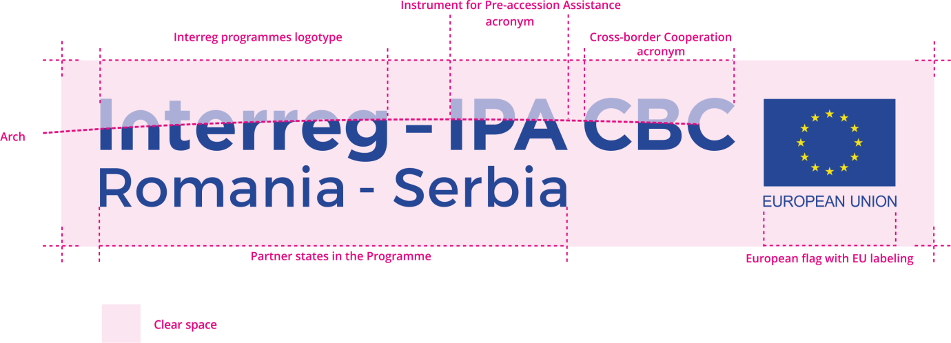
Programme logo
The Programme logo must be used on all communication materials, preferably on white background.

Slide 10
Language variations
language of the logo
=
language of the communication tool

Slide 11
Information disclaimers
Printed materials should include the following:
Programme logo;
Thematic icons of the Europe 2020 growth strategy;
A text disclaimer outlining the EU and partner states contribution to the project;
A technical box to identify the editor and the project;
EU Disclaimer within the technical box;
Contact details of Managing Authority;
Website of the Programme.

Slide 12
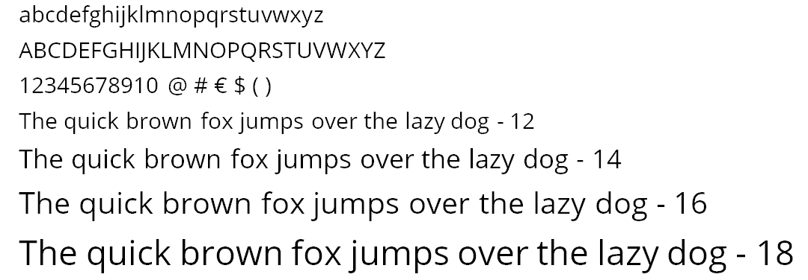
Typography / Fonts
Open Sans is the recommended font.
Contains all normal styles: regular, bold and italic.
As an alternative to Open Sans: Vollkorn, Trebuchet MS, Calibri, Arial.
Choose a font compatible with an official document style!
Avoid unusual or bizarre fonts, unless the target audience fits with your choice.

Slide 13
Europe 2020 growth strategy
European Union wants to develop a smart, sustainable and inclusive economy.
Europe 2020 growth strategy refers to employment, innovation, education, social inclusion and climate.
Within all Interreg programmes implemented all around Europe there are 11 thematic objectives to help deliver Europe 2020 goals, represented in the Interreg brand design by a system of colours and icons.
Interreg-IPA CBC Romania-Serbia Programme has chosen 4 icons to identify the priority axes.

Slide 14
Thematic objectives and icons
All beneficiaries must use the thematic icons and the system of colour for the identification of their project together with the project title and the eMS code.
P.A. 1
P.A. 2
P.A. 3
P.A. 4

Slide 15
Large range of communication tools:
Photos & Videos
Posters
(Mandatory)
Press
releases
Stories
Events
Social media / Websites
Banners &
Roll-ups
Plan carefully.
Design with creativity.

Slide 16
Press releases
Can announce a range of news items:
events;
conferences;
results of your project;
Good press-releases create:
Answer the following questions:
who? what? when? where? why? and how?
Grab attention: good headline and content;
Quantify your text: facts;
Include quotes: give a human element;
Attach photos (links to photos);
Use plain language.

Slide 17
Posters
use photos;
short texts;
create an attractive design.
Mandatory posters
The beneficiary must place at least one poster with information about the project, including the financial support from the EU, at a location visible to the public, such as the entrance area of a building.
Minimum size of the poster is A3.

Slide 18
Costs of gifts are not eligible
EU Regulation no. 481 of
4 march 2014
Gifts
Except those not exceeding EUR 50 per gift where related to promotion, communication, publicity or information.
They must be branded with Programme (EU) logo.
Photos & Videos
In all implementation stages.
Take the best photos or make sure you have the copyrights!
Keep texts short.
Please
Personalize content and tell stories.
Use sustainable materials!
Have in mind the persons with disabilities!

Slide 19
The standard logo is the full colour version.
Websites: Always displayed in colour and visible when landing on the website (without scrolling or clicking). Ideally as part of the website frame which appears on all sections.
Clearly visible and placed in a prominent position.
EU flag should be the biggest logo on the page.
EU flag
Programme logo
Joint Secretariat offers advice for all beneficiaries regarding Visual Identity Rules and Communication.
Support

